Slide 1
Criminal Justice – Behavioral Health
Partnerships Promoting Integrated Healthcare Conference
Evaluating the Current System
How does it fit together?
How can I change it?
What changes need to be affected?
Gilbert Gonzales,
Bexar County, Director
Department of Behavioral and Mental Health
San Antonio, Texas
grgonzales@bexar.org
IBHI/CHCS
January 29 – 31, 2017
Hotel Contessa
San Antonio, Texas

Slide 2


System integration is defined as the process of bringing together the component subsystems into one system and ensuring that the subsystems function together as a system.

Slide 3


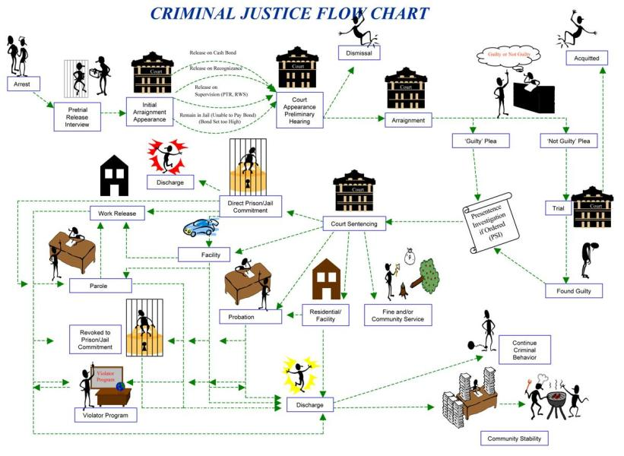


Slide 4
Community Mental Health Continuum Model
Cross
System
s
Crisis
Sick Care
Wellness
Intervention
Coordination of Care
Prevention - Wellness
Quality of Life
Housing
Supportive Employmt
Judicial
Community
Guardianship
Trauma Informed
Care
Intensive Outpatient
Medication - access
911, CIT, Fire/EMS
Secure Facilities
Outpatient Services
Community Support
Residential Levels
Stabilization
Transitional
Transitional Care
ER-Hospital
Transportation
Crisis
Jail
Target Areas:
1. Navigator: Coordination Portal (Law Enforcement/Community)
2. Continuity of Care with focus on Residential Continuum/Supportive Housing
3. Outpatient Access- Gaps , Sharing information
4.Public Service Announcements
5.Evaluation
Child-Family
Adoles-Family
Adult-Family
Older Adult-Family

Slide 5
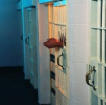






Jail
Diversion
Step-
downs
Data, Research &
Innovation
Therapeutic
Justice Initiatives
Probation
Police, Sheriff, Fire-EMS
Joint Community Based
Crisis Intervention Training
Crisis Care Center
Restoration
Center
Prospect Court Yard-Haven for Hope
Parole
Crisis Outreach
Teams (MCOT)
Veterans
Jail Diversion
Trauma Recovery
Psychiatric
Evaluation
23 hr Hold
Community
Reintegration
Med Clearance
San Antonio State Hospital
or other Inpatient Hospitals
MI Offender’s
Facility
CTU Transitional
Appropriate
Disposition
Contract Beds
Substance Abuse Treatment Facility 1
Residential
Services -
Section 8
Housing
Substance Abuse Treatment Facility 2
Substance Abuse
Sobering
Criminal Courts
Detox
Injured Prisoners
SA Outpatient Txt
Mental
Health
Felony
Drug
Misdemeanor
Drug
Services
Drug Court
Community
Outpatient Clinics
Adult/Child
Safe Sleeping
Transitional
Peer Advocates
NGRI
Community
DWI
Veterans
MH Clinic
Long Term Health,
Residential and Day Hab
Home Health
DAHS, ECI, Head Start
Services
80 Bed MH
Residential
Next Day Appt
SA In House
Recovery
Homeless
Adults
Forensic
Outpatient
Competency
Restoration
Civil Probate Court
Involuntary
Outpatient
Commitment
Opioid Addiction
Serving
Families
Opioid Pregnant Females
HIV Outreach
Children
Outpatient Alcohol and Drugs Counseling

Slide 6
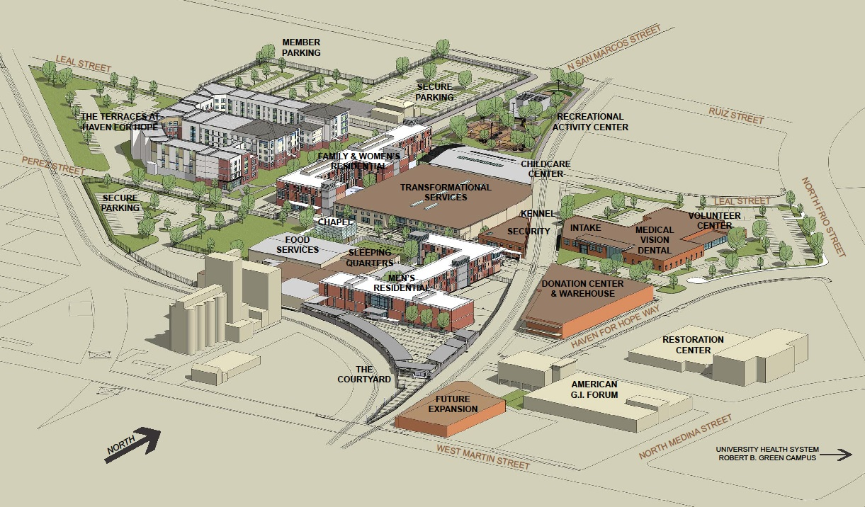
CHCS
Restoration
Center
CIT
Crisis (Psych/SA)
Sobering
Medical Clearance
Detox
In House Recovery access
Haven for Hope
Site Map
Haven for Hope
Safe Sleeping
Integrated health care
Transitional Homeless Campus +
Crisis
Med Clearance
Sobering
Detox
Methadone
Central Magistration
JAIL
Reentry Center
Judicial Services/Mental Health
100% MH Screening
Law Enforcement (Screening LE4)
Public Defenders
MH Clinical Assessments
Pretrial, clinical, PD integration
Direct Access to Treatment
Criminal Justice Coordinating Council
Criminal Justice Improvement Initiatives
Mental Health Consortium

Slide 7
Diversion 1.0
Diversion 2.0
Diversion 3.0
2003 to 2017 Community Medical Directors Roundtable - Monthly Reports
2004 Measuring Potential and Economic and Societal Benefits
2007 Cost Analysis of the Bexar County, Texas, Jail Diversion Program
2008 to 2016 Report of Success; Annual
2014 Bexar County Pretrial and Mental Health Improvement Process
2015 Bexar County Smart Justice: Implementation Year One Progress
2016 Council of State Governments Intake Process and
Recommendations for Change
2015 Bexar County Consortium – Community Mental Health Model
2016 MHM/Meadows – Bexar County Mental Health Systems Assessment
2016 MHM/Capital Healthcare Planning – Bexar County High Utilizers/Homeless
Healthcare Analysis (Cost)

Slide 8
Diversion 1.0
Sequential Intercept 1
Diversion - Pre Arrest Early Intervention
Crisis Intervention Training for Law Enforcement and First Responders
40 hour Community based, no charge
Mandated training for Patrol by Sheriff and SAPD
Diversion - 24/7 Drop Off (Restoration Center)
Sequential
Intercept 1
Co-taught by San Antonio Police and the Bexar County Sheriff’s Office
Psychiatric and Substance Use Crisis Services
Mobile Outreach Teams
Over 4,000 Officers Trained
Medical Clearance for Law Enforcement
Sobering Center
Detox Center
Over 18,600 Accessed Services at the Restoration Center in FY 15

Slide 9
Diversion 2.0 Magistraton
Counsel of State Governments: Dr. Tony Fabelo
Sequential Intercept 2
Initial Detention
Four Mental Health Questions asked by all law enforcement
Sequential Intercept 2
Magistration
Introduction of Public Defender
Direct transfer to treatment Services
Expanding Mental Health assessments, early identification
100 % Screening
Integration of Pretrial Services, Public Defender, Mental Health and Hospital District
Suicide Screening and Assessment
Team Presentation to Judge

Slide 10

In Bexar County, the total
cost of providing
Healthcare for the Safety
Net Population
in 2015 as a whole
exceeds:
One Billion $ Dollars
Draft Methodist Healthcare Ministries
Bexar County High Utilizers / Homeless Healthcare Analysis
Capital Healthcare Planning Oct 13, 2016

Slide 11
Diversion 3.0
• The 2,600 cases each year of “super-utilizers” (most with co- morbid substance use disorders) in poverty at highest risk of using jails, hospitals, ERs, or homeless services;
• About 300 new cases each year of psychosis (including schizophrenia) among older adolescents / young adults at high risk to become “super-utilizers” if not treated early; and
• Approximately 2,200 children and adolescents in need of time-limited, intensive home and community-based supports to avoid or reduce risk of out-of-home or out-of-school placement,
including many in or at risk of the child welfare and juvenile justice systems.

Slide 12


Slide 13
1,000 empty jail beds
Approximately $96 million in cost avoidance at jail
Over 35,000 helped with sobering,
detox and crisis intervention
Outcomes
Reduced Jail Population
Reduced Recidivism
Reduced Cost
Increased access to care
Increased public safety
Downtown Homeless Count
down by 80%
8,000 lives improved by transition
to homes (3,000) and off streets plus
higher level of care
Jan- Oct 2016
41,252 individuals screened for Mental Health
8,644 (20%) Individuals Identified with a MH Indicator
304 Released to the PR Bond MH
April 2014-October 2016 in Treatment Program
622 Individuals Diverted
90% Successful Court Appearance rate
4% Re-arrest for New Offense

Slide 14
BEXAR COUNTY
DEPARTMENT OF BEHAVIORAL AND MENTAL HEALTH
Paul Elizondo Tower, 101 W. Nueva, Suite 310
San Antonio, Texas 78205
www.bexar.org/mhd
Gilbert Gonzales - Director
grgonzales@bexar.org (210) 335-0071

