Slide 1
Creating Meaningful System Change
Denver Sequential Intercept Model
2006 - 2017

Slide 2
Our Journey

Slide 3
Our History
Crime Prevention and Control Commission (CPCC), 2005:
Reduce crime and delinquency in Denver through an evidence-based, accountable, and efficient public safety strategy.
Office of Behavioral Health Strategies (OBHS), 2015:
Creating a Proactive, Responsive and Integrated strategy for mental wellness in Denver: “PRISM – Your Mind Matters”
Using the SIM since 2006 (adult), 2009 (juvenile) to innovate system change

Slide 4
Core Areas of Work
Develop a data-informed and integrated:
criminal justice system
mental wellness spectrum
Improve our ability to address the needs of individuals and mental wellness in our communities
Improve system efficiency, effectiveness, and collaboration within and across systems and disciplines
Evaluate the current state of mental health, and criminal justice practices and services
Improve criminal and juvenile justice resource utilization, jail population management, and reduce incarceration

Slide 5
Guiding Principles
Goal Statement for Commission
System-involved persons have access to a continuum of appropriate and coordinated mental wellness and behavioral management services to improve and promote public safety and individual well-being.
Core Values
Treat system-involved persons with behavioral health disorders with respect and honor their rights and needs
Act with integrity and accountability and demonstrate trust
Treat every individual with a trauma-informed approach

Slide 6
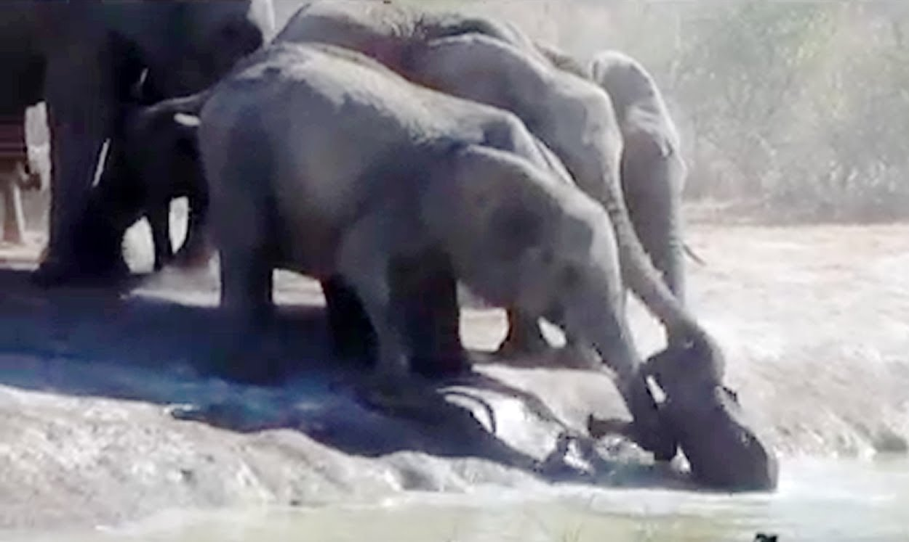
It’s All About
Collaboration!

Slide 7
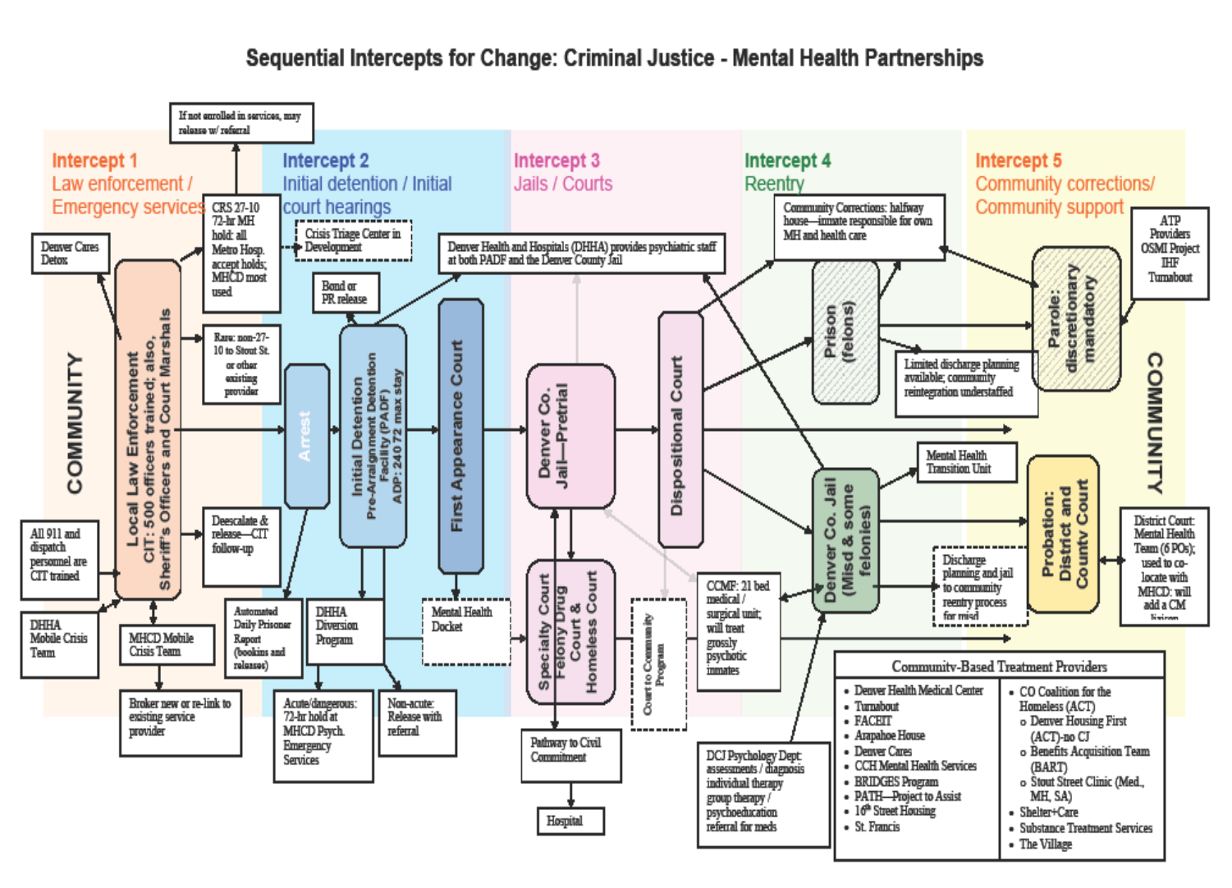
Sequential Intercepts for Change:
Criminal Justice – Mental Health Partnerships

Slide 8
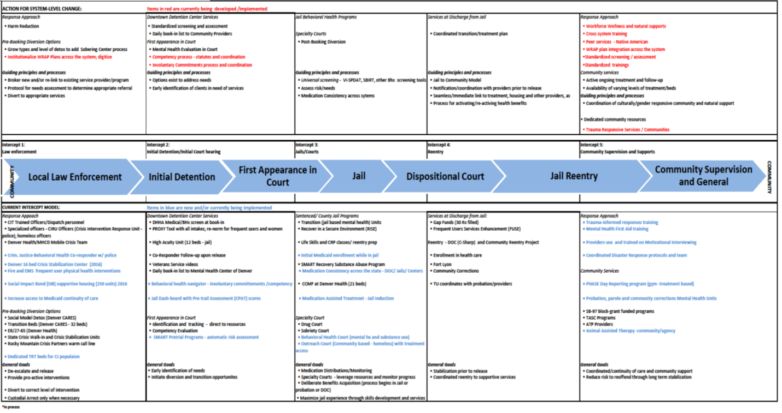
Sequential Intercepts for Change:
Behavioral Health Partnerships (2006-2016)
Developed by Mark R. Munetz, MD and Patricia A. Griffin, PhD through SMAHSA/CMHS GAINS Center
Assesses states and communities for available resources to determine gaps in services and plan for community change
Identifies opportunities and diversion programs to assist justice-involved individuals with serious mental health needs to services
Help to create diversion programs to assist individuals
Assists in providing adequate services for individuals in correctional facilities with serious mental illness
Reentry programs for individuals with a serious mental illness transitioning back into the community from correctional facilities

Slide 9
Intercept 1 - Time of Crisis
• CIT Training – Police Officers/Dispatch personnel (99%) - Sheriff – will be 100% in 2017; Fire
• Crisis Intervention Response Unit (CIRU)
- Mobile Crisis: Hospital /mental hx center (MHCD)
- Co-Responders across first responders (20 in 2017) Behavioral Health, Opioid, Child Specialist Human Services, Homeless and Library
• Fire and EMS HOP – homeless shelter outreach medical
Denver Juvenile Services Center – secure and non facility. 10 + agencies co-located; common assessment; prevention – Tx
Pre-Arrest/Booking Diversion Options
- Social Model Detox (Denver CARES)
- Transition Beds (Denver CARES - 30 beds/15 CJ)
- ER/27-65 (Denver Health – adult/ youth beds)
- State Crisis Stabilization Units: walk in and mental health holds; Denver unit in 2017
- Colorado Crisis Services – warm crisis call line; resource bank; peers
- Fort Lyon homeless/addiction 90 day -2 yr program
- Social Impact Bond housing (250 units)
• Opioid Interventions: - First Responders /Crim. Justice providers carry Naloxone - Needle exchange programs
Focus
Be Proactive
Embrace harm reduction
Create a net: De-escalate & follow-up
Align and leverage cross discipline resources

Slide 10
Intercept 2 Initial intake and court process; alternative tracks/options
• Comprehensive differential assessment: Medical, mental health and substance use (2017) Police / hospital Sick and Injured form WRAP and Developmental Disabilities (2017) PROXY Tool to track for jail based services Pre-trial assessment, ODARA, LSI and WRNA Competency evaluation
• Comprehensive Pre-trial options and matrix
• Specialized housing and services High Acuity Unit (12 beds) Correctional Care Management Facility (CCMF)
• System Navigation and Reminders - Court reminder cards - Daily jail “intake/release” list to providers - Behavioral Health and Opioid Navigators
• Specialty Courts and Services Drug Court and Veteran Docket Sobriety Court Recovery Court Outreach Court (homeless shelter w/treatment and UPS)
Focus
• Assess/identify
needs
Pre-trial release
Stabilize and safety
“Give‘em a nudge” and direct support
Combine accountability and treatment

Slide 11
Intercept 3 Incarcerated: opportunities for treatment and interventions
• Jail-based Treatment Units/Services Mental Health “Transition Units” (TU) Addiction units “Recover in a Secure Environment” (RISE) Jail to Community (Life Skills/Community Reentry Project (CRP) SMART Recovery substance abuse (CBT)
• Denver Health and Hospital Medical and Substance Use Services Jail-based Medication Assisted Treatment Methadone maintenance/dosing CCMF (21 beds)
• Medication Stabilization: Statewide formulary and medication consistency – DOC, State Hospital, County Jails, Mental Health Centers (2017)
Focus
Assess risk and needs
Address presenting issues
Increase stabilization
Access to services
Respond to populations with targeted resources

Slide 12
Intercept 4 Jail to Community
• Medication Stabilization, continued: 30 day filled prescription upon release Naloxone upon release
• Frequent Users Services Enhancement (FUSE)
• Community Reentry Project:
• Benefit Enrollment in Jail Veteran video and supports Enrollment in health care “turned on”
• State Criminal Justice - Community Corrections - C-Sharp grant – DOC release - DOC Homeless team - DOC reentry services
Focus
Warm hand-offs
Stabilize persons as much as possible
Continuity of services: Initiate in jail and continue into community
Community supports visible and available in jail
Ensure information about services is provided

Slide 13
Intercept 5 Community Supports and Interventions
• Capacity Building and Mental Wellness Infrastructure - Trauma-informed Practice training and program development; Trauma informed community development - Mental Health First Aid training (youth and adult) across city agencies and community - HIPAA/ CFR 42.2 Forum - Motivational Interviewing: training/ coaching/ proficiency - Cross system training
• Psychological disaster response protocols and team
• Partnership with Community Wellness Network – Peers - WRAP plan advocacy and implementation
•Cultural responsive focus: - GRASP and GRID (gang intervention) - American Indian, - Youth - Ageing - African American - GLBTQ
• PRISM Strategic Plan: Your Mind Matters - Website - Commercials - Governance
Focus
Foster natural supports / peers
Develop cross discipline relationships
Re-weave the net
Build provider capacity
Maximize resources
Honor culture

Slide 14
Intercept 5 Community Supports and Interventions (Continued)
• Leverage Funding - Medicaid and benefit enrollment - State funded (SB-97) mental health services - TASC Program and ATP Providers • Marijuana Diversion Funds - Check Your Head - Music and Arts - School curriculum - Parent training - Alternatives and diversion - Police/youth relations
• Specialized Mental Health Treatment Teams - Probation (County and District) and Parole
• Case reviews and problem solving
• Trauma informed workforce development
• Specific Programs - PHASE Day Reporting program (mental health, trauma, addiction treatment in a gym setting with supervisors; court and probation based support - Animal Assisted Therapy – 4 pilot sites
Focus
Foster natural supports / peers
Develop cross discipline relationships
Re-weave the net
Build provider capacity
Maximize resources
Honor culture

Slide 15
Lessons Learned
Infuse SIM language across stakeholder groups
Use the SIM outcomes
Up-date it regularly
Data speaks!
Costs get attention!
Continuous process improvement is vital to achieving desired outcomes.
Each partnering agency has to “own” their part of the work and population.

Slide 16
Lessons Learned
Create a new box
Make uncommon knowledge common
It didn’t happen if you don’t tell the story
Let others own “it”
Timing is everything!
High needs persons can be successful with the right structure and resources
Proactive resource utilization is key to successful outcomes
Housing continues to be our number one barrier to sustainability
Spice it up - Include unusual partners; include those with lived experience

Slide 17
Finally, remember…
Is always in play…

Slide 18
Regina Huerter
Office of Behavioral Health Strategies
Denver, Colorado
regina.huerter@denvergov.org
720-641-5008

